Slide 1

About Me
Name : Shinde Deepali R Tipirneni
Qualification : BSC.IT
Work Experience : 8 years in Educational & medical field .

Slide 2
What is web Scraping ?
Access and collect
Don’t have to sign up for an API key
Not limited to a specific number of queries

Slide 3


Slide 4
Analyze & visualize data of properties from 99 Acers website.
Business Statement

Slide 5
Explanation about Use case title and domain
01
Domain of “Real Estate”.
Different types of properties by visualizing them.
02
03
Properties in Hyderabad

Slide 6
How I scraped my data?
A
Found the URL that I wanted to scrape
B
Inspected the Page
C
Find the data i wanted to extract
D
Wrote & Run the code and extract the data
E
Stored the data in the required format

Slide 7
Libraries used for web scraping
Tools:
Requests Library - make HTML requests to the website’s server for retrieving the data on its page.
Beautiful Soup – HTML Parser
Pandas, NumPy – To analyze the data
Matplotlib, Seaborn – To visualize the data

Slide 8
Data Cleaning
Cleaning poorly formatted columns from the extracted raw data
Skipping rows with Nan values.
Removing duplicated rows.
Changing the data types for necessary columns
Filtering the Data Frame and storing it to a csv file

Slide 9
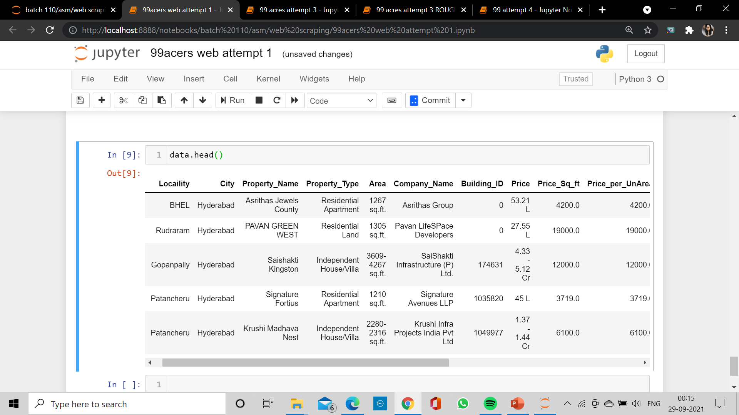
Before Cleaning

Slide 10
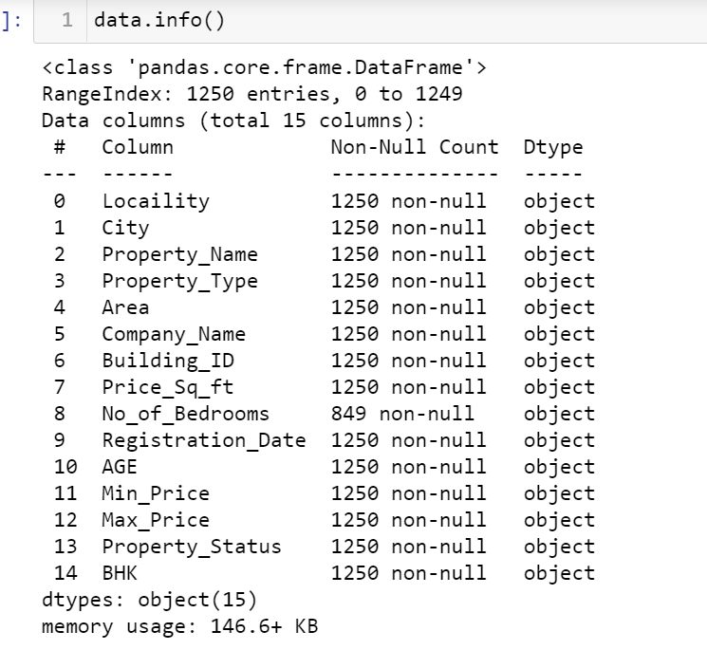
Before changing dtypes

Slide 11
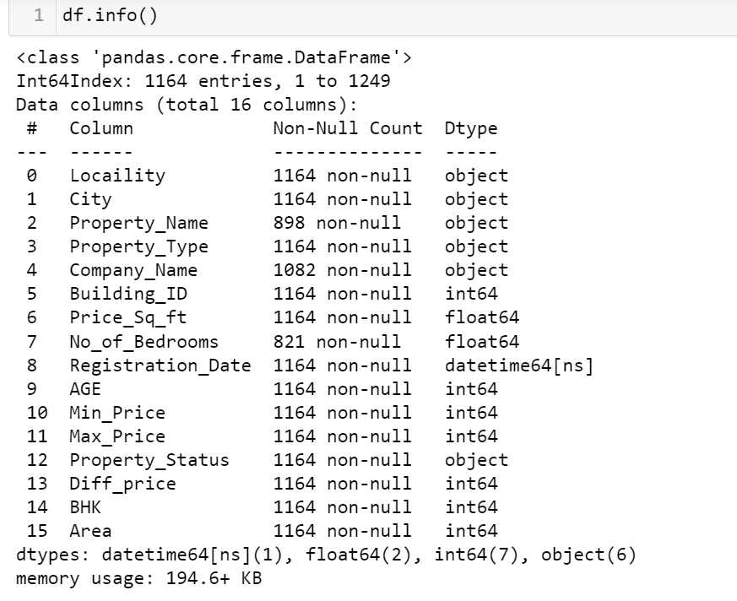
After Changing dtypes

Slide 12
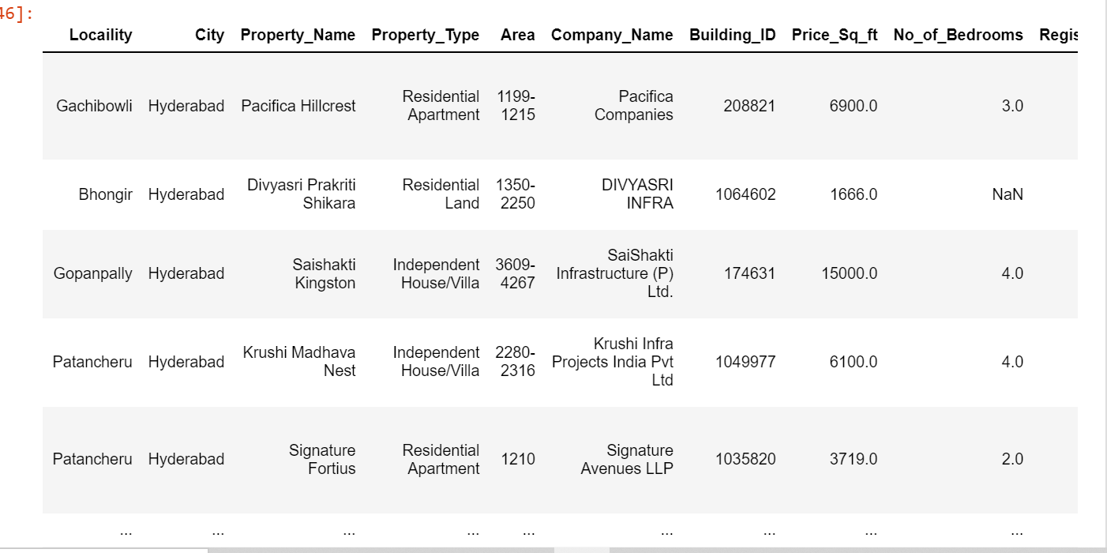
After Cleaning

Slide 13
Data Visualization

Slide 14
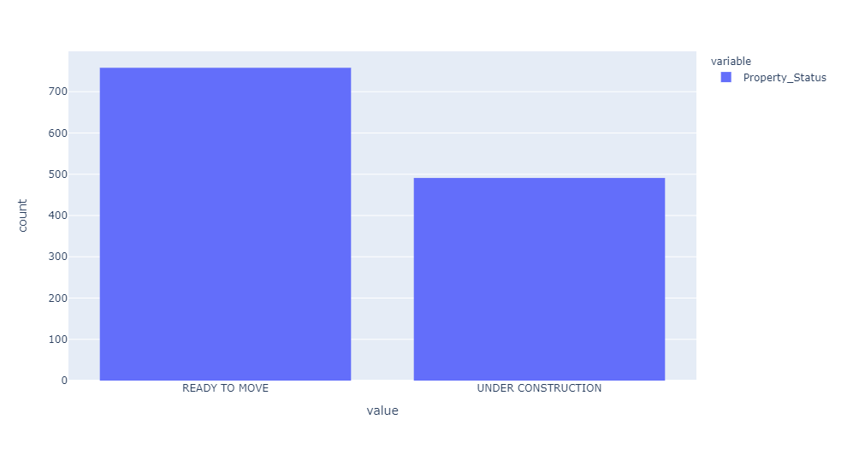
Total No. of Under Construction & Ready to move properties
Total no of properties are 1249.
Ready to move properties have highest number around 698 in Hyderabad.
Under construction has a least number of properties around 491.

Slide 15
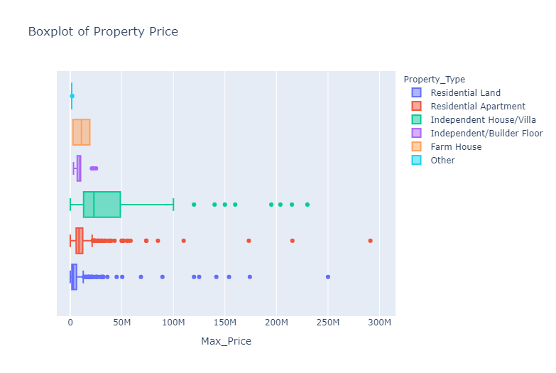

Slide 16
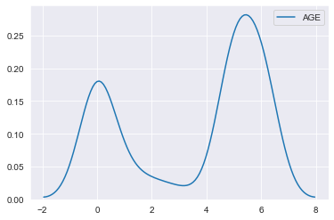
Years old Properties
There total 326 properties newly constructed and ready to move in this year.
56 properties are 1 year old
38 properties are 2 years old
25 properties are 3 year old
338 properties are 6 years old
381 are 5 year old

Slide 17
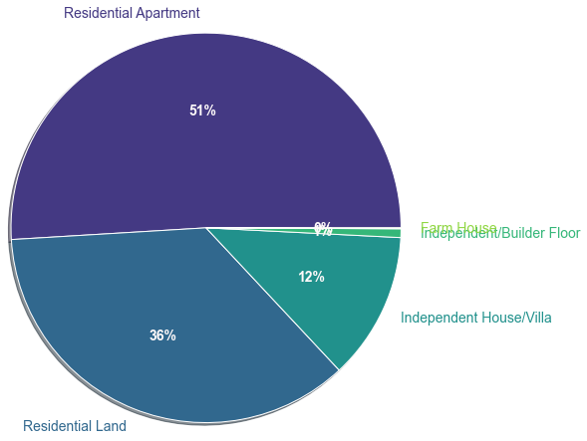
No of bedrooms Vs Property Types
51% is the Highest registered property for residential apartment starting from 1 to 3bhk
12% is registered for independent house/villa, 36% are residential land
Where as only 0.123% booked for farm house and oher lands

Slide 18
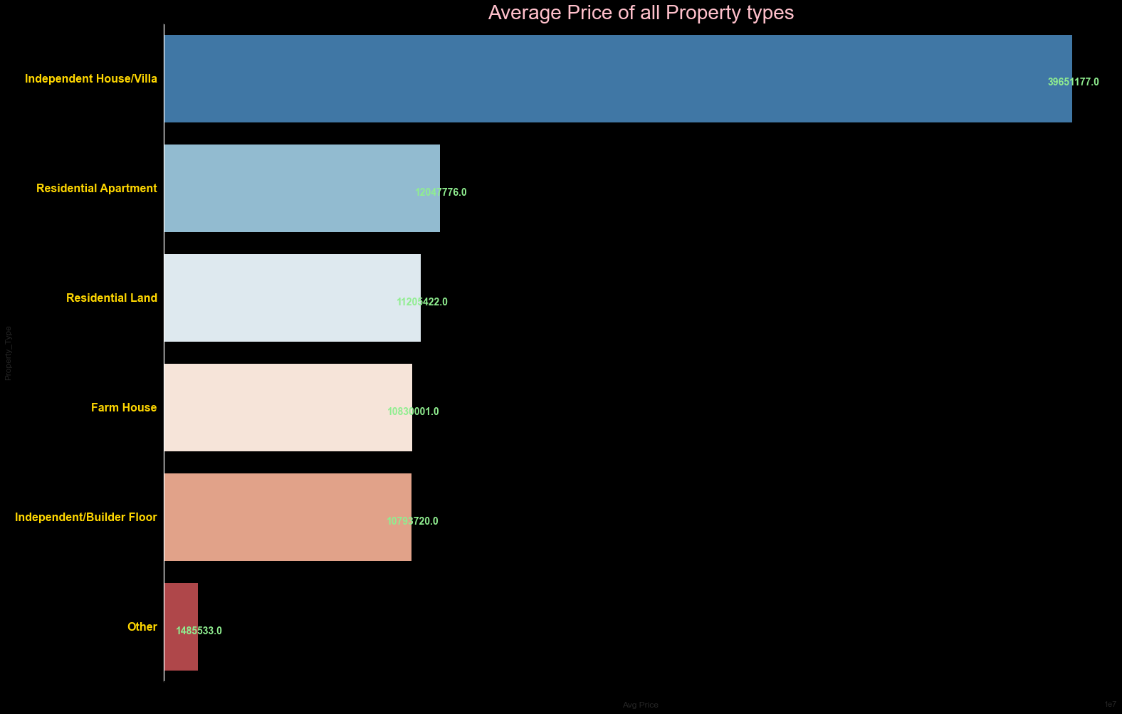
Independ house/villa has the highest avg price of around (3.9Cr),followed by Residential Apt(1.2Cr),Residential land (1.1Cr),Farm House(10L)
Least is Independent floor & other plots around (10L to 14L)

Slide 19
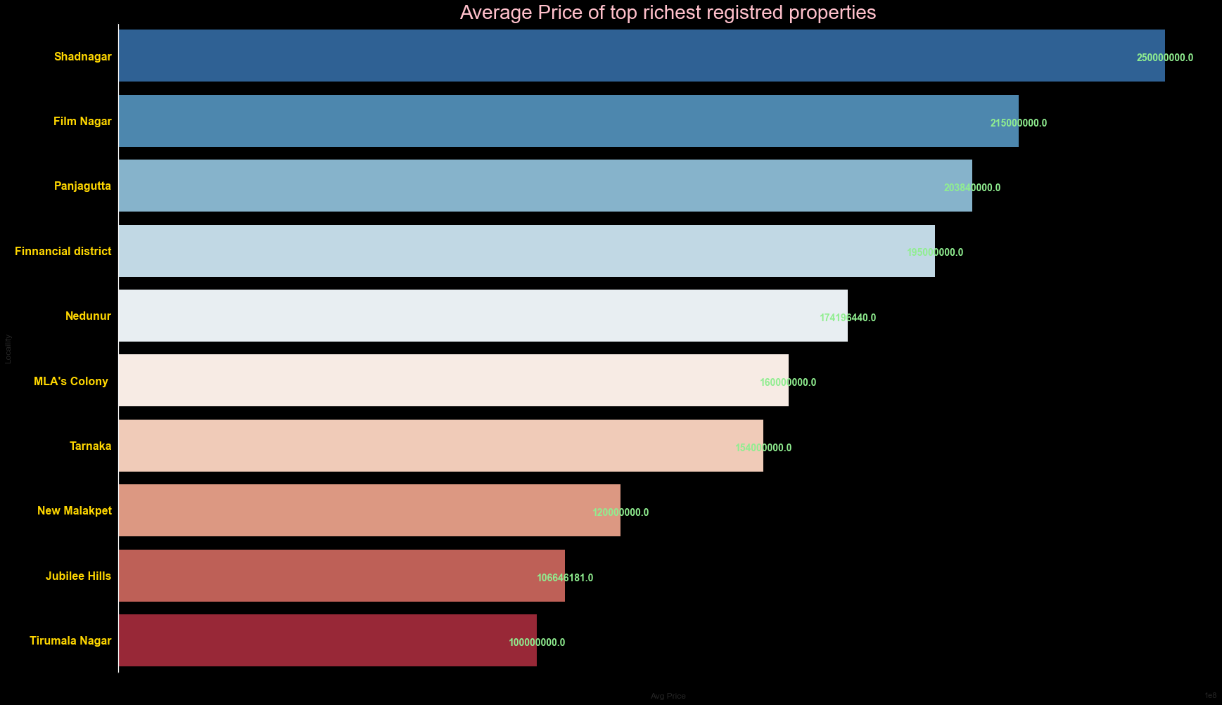
Starting avg price 250Cr in Shadnagar , to 100Cr to Tirumala Nagar

Slide 20
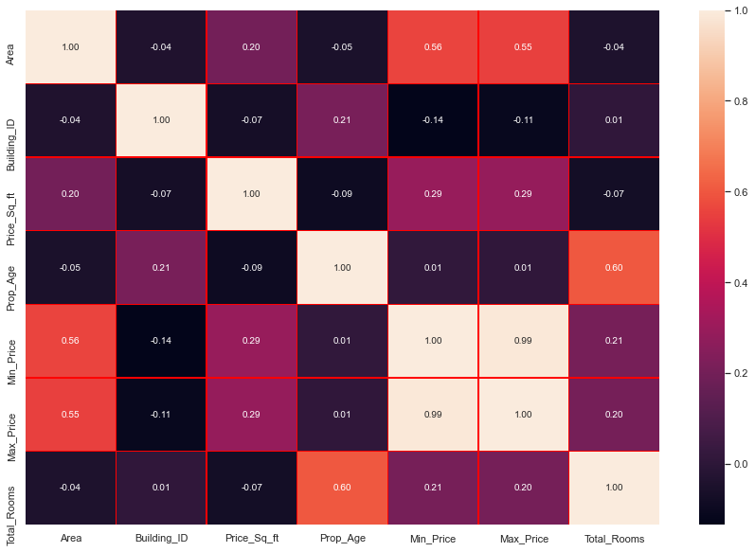
Here no.of bhk and no of bed rooms are positively co related ,same with minimum last year price and current year max price

Slide 21
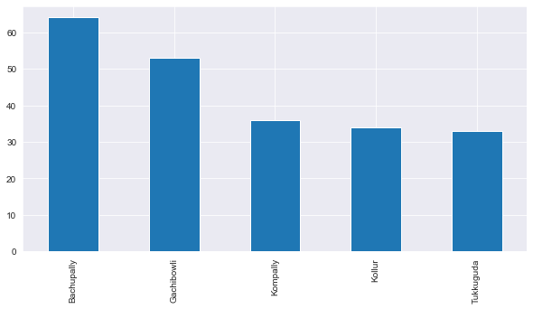
Top 6 Localities highly increasing
There are total 65 registered properties in last 3 months starting from 1BHK to 3BHK, with 600-1800 Area sq.ft in Bachupally staring from 35L
2nd largest is Gachibowli , total 53 were registered Area sqft 206 – 6666sqft containing 2bhk – 6bhk
Kompally containing 39 records , price starting from 37L- 2CR with 266 Are sqft to 18,216 sqft
Kollur has 34 records 35L-4.5Cr 211sqft to 4295sqft
Tukkuguda 33 records minimum 167Area sqft to 21,510Area sqft . Starting range from 11L to 8.5CR

Slide 22
THANK YOU

